Slide 1
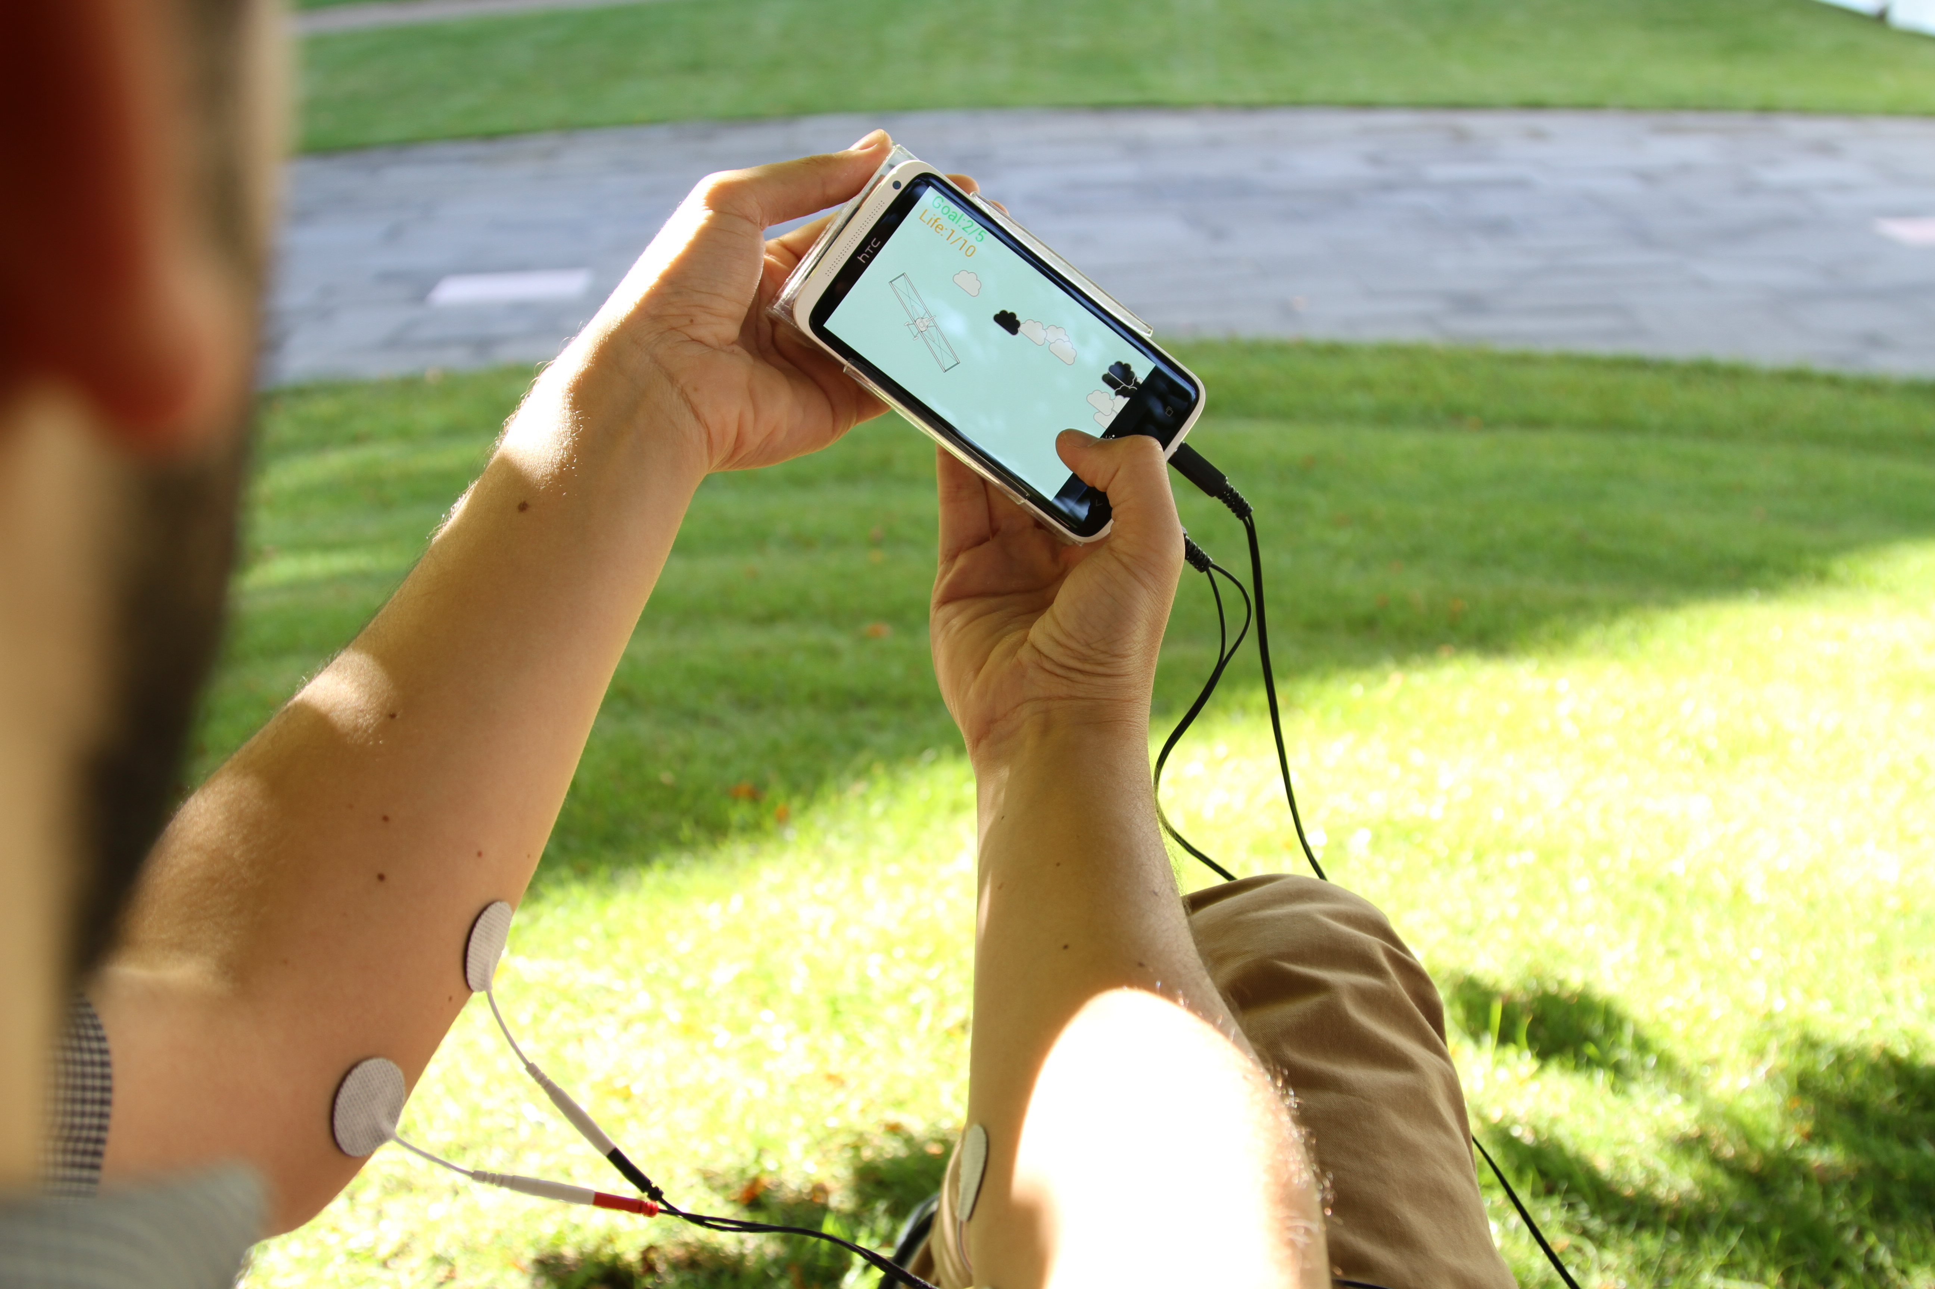

talking directly to the body: the user’s
muscles as input & output device by
using electrical muscle stimulation
pedro lopes // human computer interaction lab // sketching in hardware

Slide 2
motivation [why is immersion not yet mobile?]
Notes:
presentation goes up again, to the level that people at RS can relate to…

Slide 3
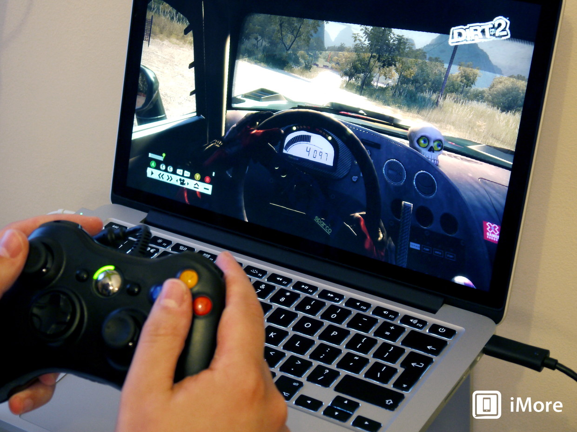
...graphics were the first key to immersion
Notes:
from gaming

Slide 4
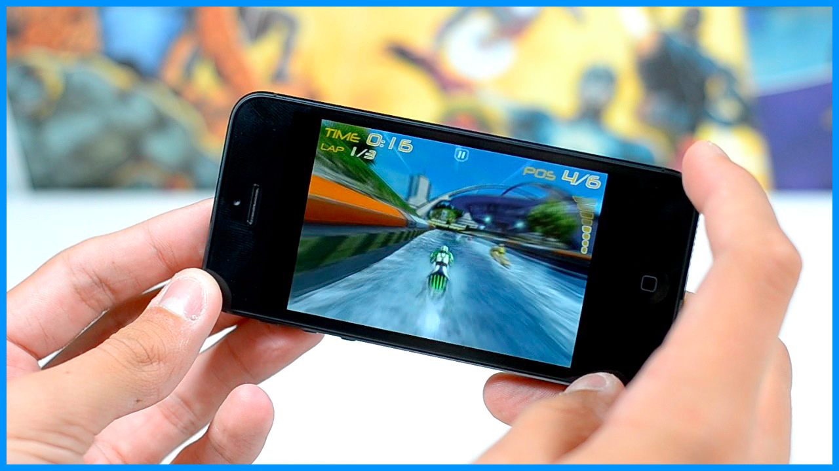
...and then came motion sensors
Notes:
With graphics and user interaction now part of many games, many researchers argue that haptics and motion are the next step towards increasing immersion and realism, and while weaker forms of haptics, such as this chair from disney research with vibration motors are slowly maing their way into industry, large scale motion/actuation, the type needed for realism and immersion,
i.e., applying the forces triggered by the game onto the player’s body during the experience, is difficult to attain!

Slide 5
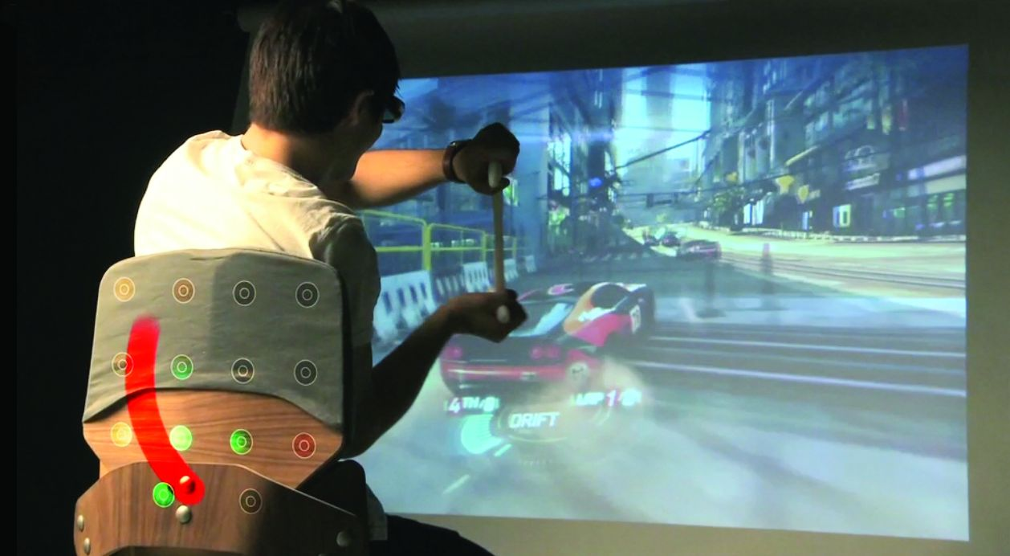
now researchers say:
haptics is the next step towards realism!
[ali israr]
Notes:
With graphics and user interaction now part of many games, many researchers argue that haptics and motion are the next step towards increasing immersion and realism, and while weaker forms of haptics, such as this chair from disney research with vibration motors are slowly maing their way into industry, large scale motion/actuation, the type needed for realism and immersion,
i.e., applying the forces triggered by the game onto the player’s body during the experience, is difficult to attain!

Slide 6
…haptics on mobile devices are weak
Notes:
With graphics and user interaction now part of many games, many researchers argue that haptics and motion are the next step towards increasing immersion and realism, and while weaker forms of haptics, such as this chair from disney research with vibration motors are slowly maing their way into industry, large scale motion/actuation, the type needed for realism and immersion,
i.e., applying the forces triggered by the game onto the player’s body during the experience, is difficult to attain!

Slide 7
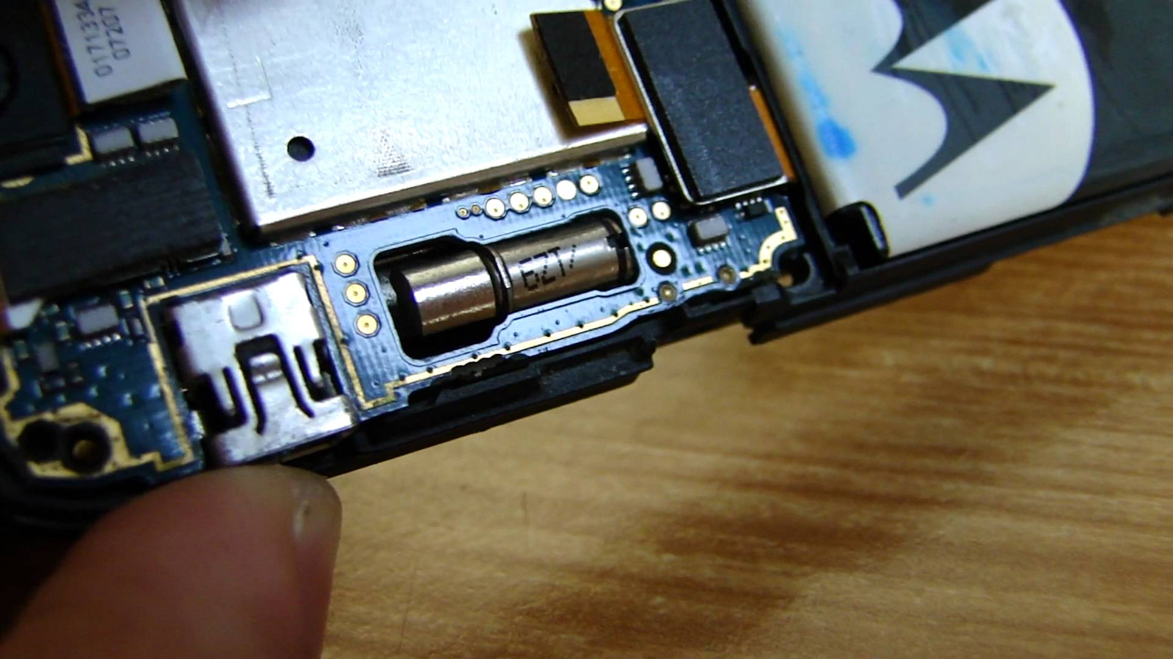
such as vibration, small actuators, etc…
Notes:
While some force events can be realistically rendered using one or more vibrotactile actuators (e.g., driving over gravel in a racing game [15]), a much larger number of gaming events result in directional forces, such as centrifugal forces pulling at a steering wheel or a car bumping into the railing.

Slide 8
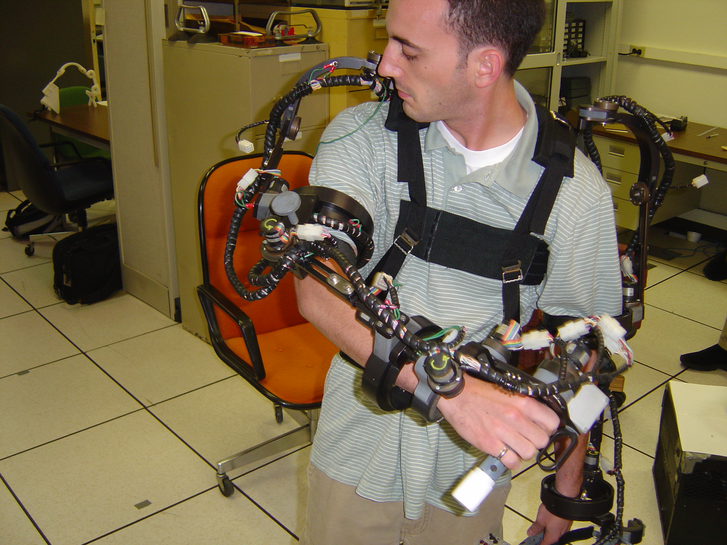
for large actuation and mobility
researchers focused on exoskeletons
but these are heavy and get in the way
Notes:
Unfortunately, the size and weight of these devices tends to be proportional to what they actuate. . exoskeles are based on motors makes the hardware exremtly heavy and get in the way of the user. making them hard for mobile situations.

Slide 9
so that’s the challenge we tackle
provide sense of realistic forces,
through substantially smaller hardware
Notes:
My research explores how to achieve similar effects as motion platforms and exoskeletons BUT using mobile hardware.

Slide 10
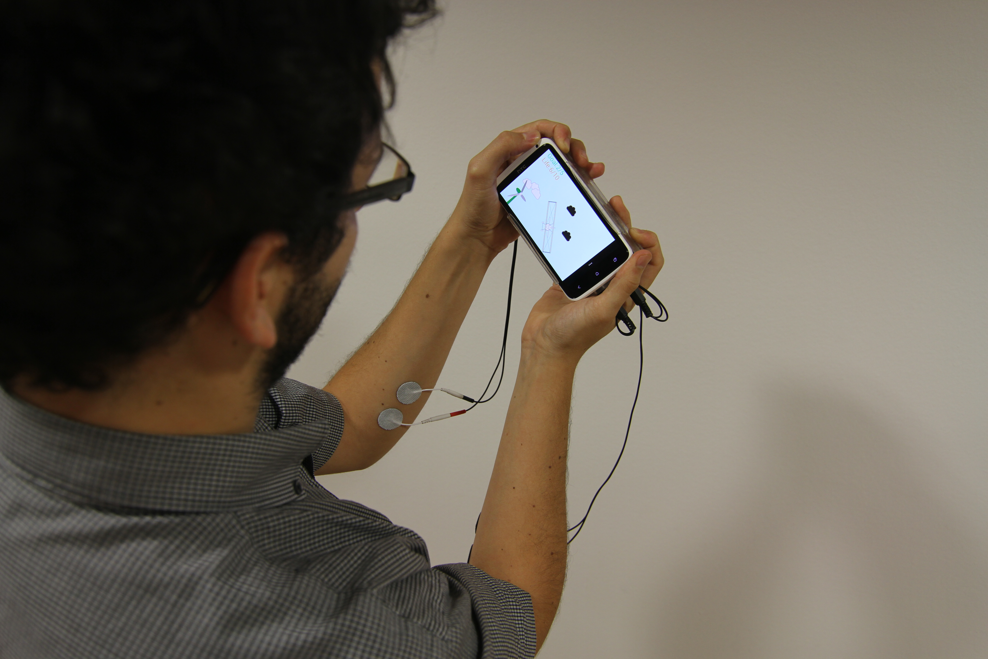
chi’13
muscle-propelled force feedback
bringing force feedback to mobile devices

Slide 11
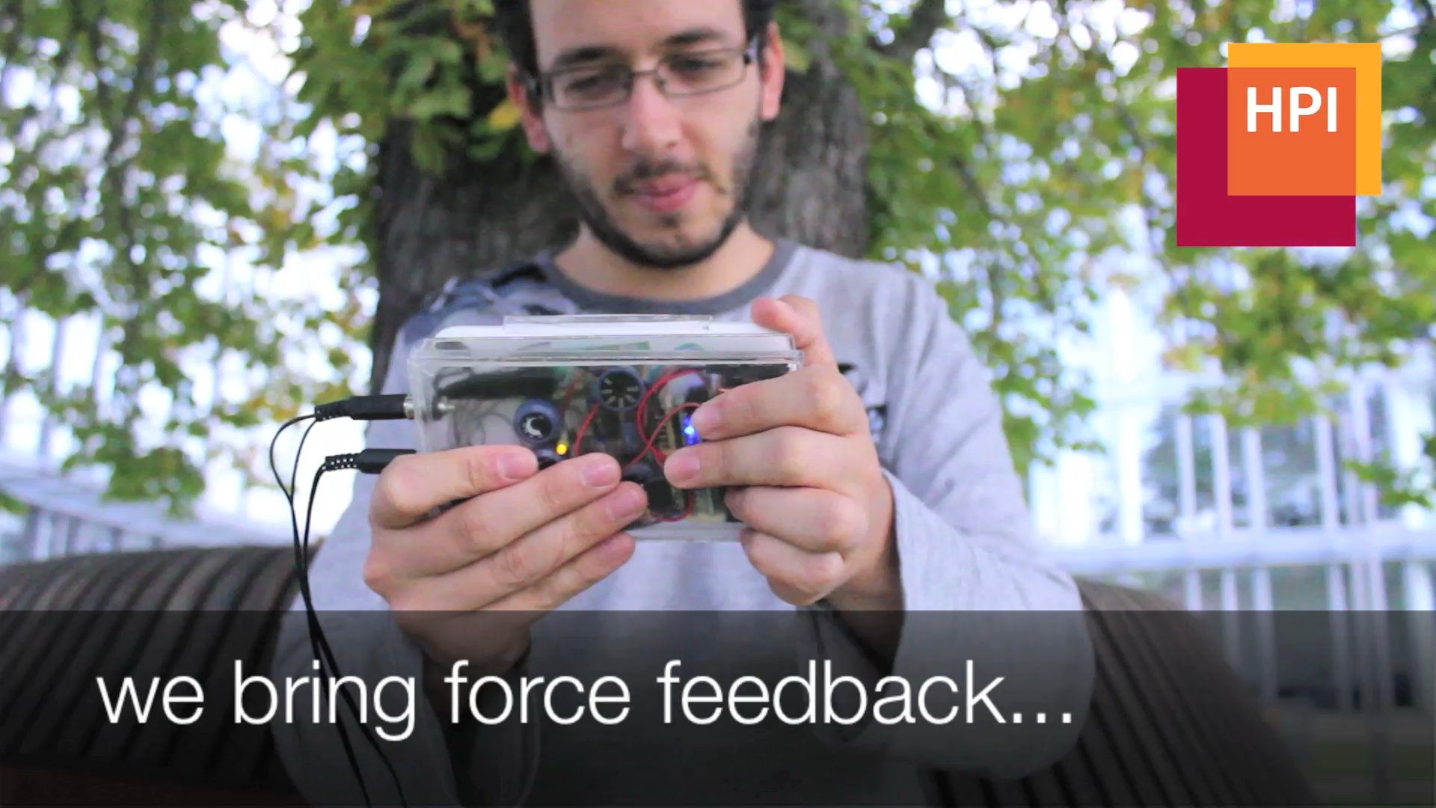

Slide 13
electrical
muscle
stimulation

Slide 14
user
counteracts
and resists
... the user perceives force feedback

Slide 15
... device has no motors or actuators

Slide 16
battery
carbs
skeleton
exoskeleton
motors
muscles
contribution:: mobile force feedback

Slide 17
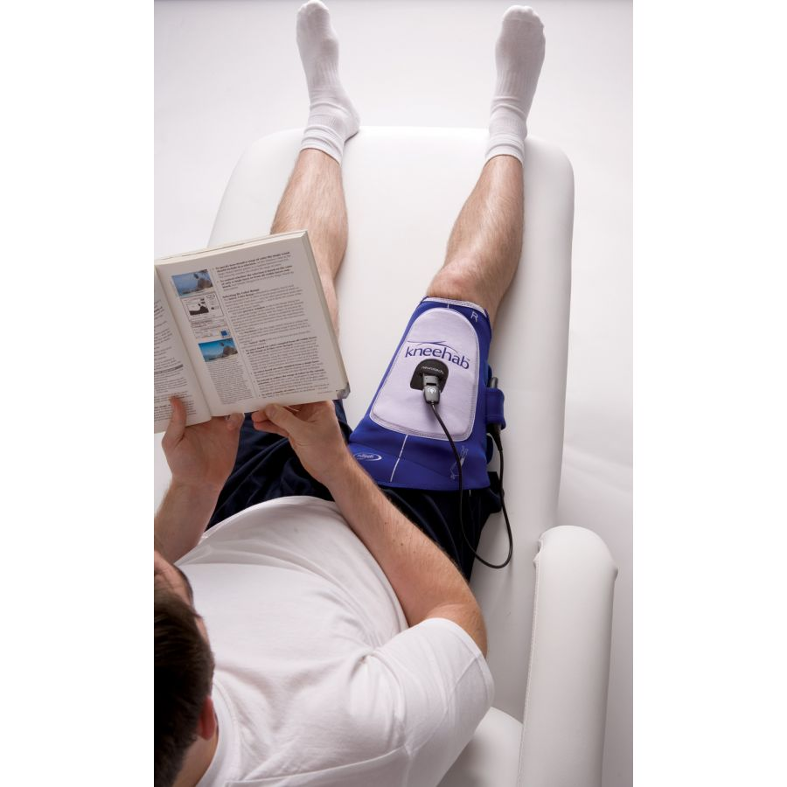
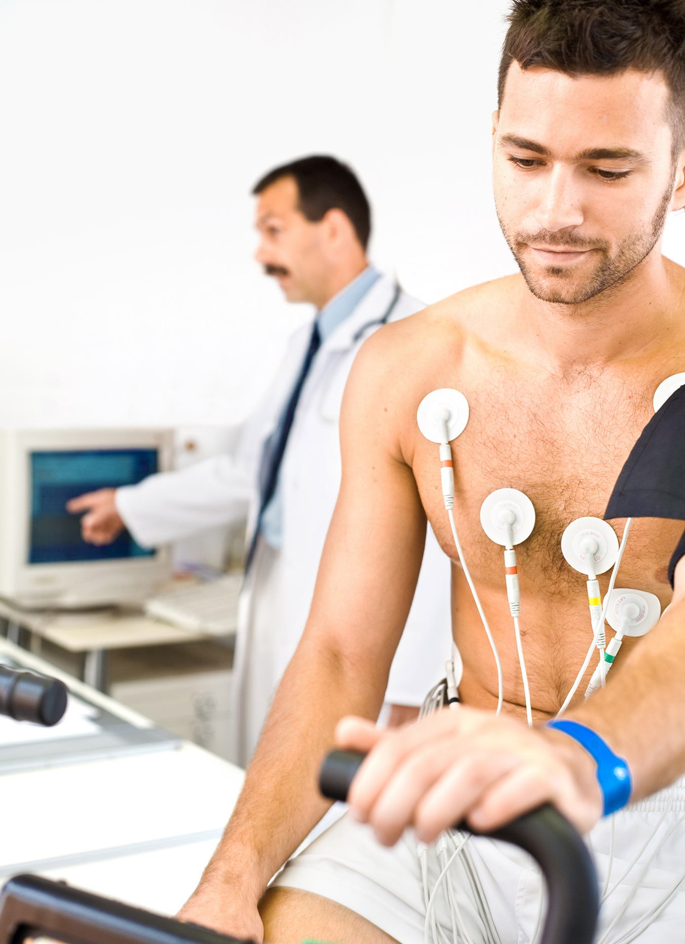
rehabilitation, since the 60’s

Slide 18
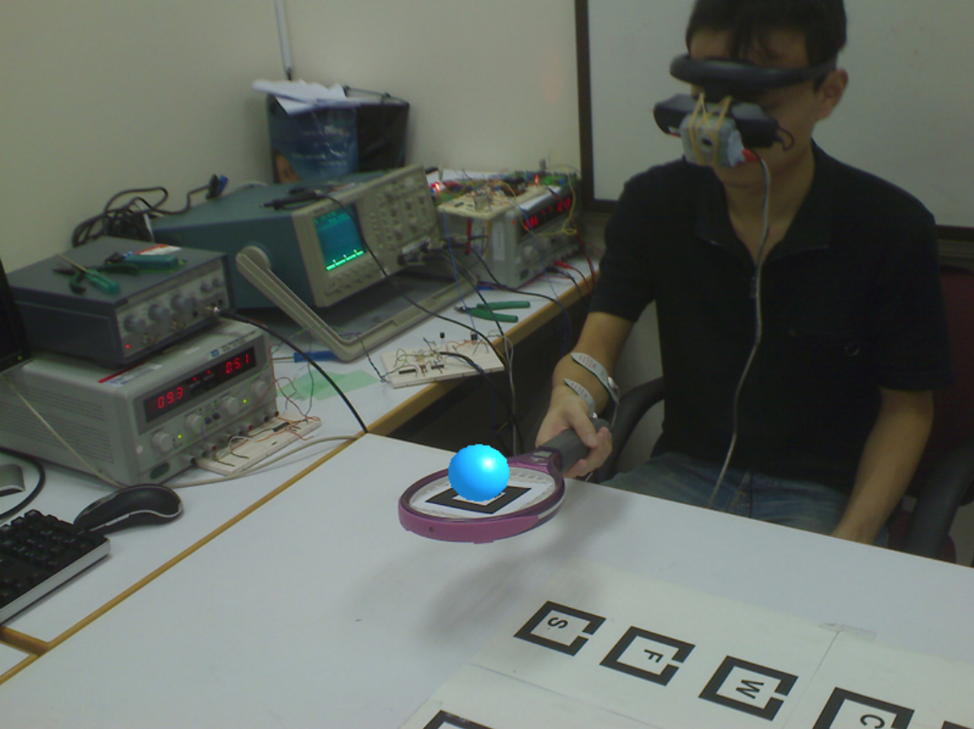
augmented tennis with muscle stimulation
[farbiz et. al, ‘07]

Slide 19
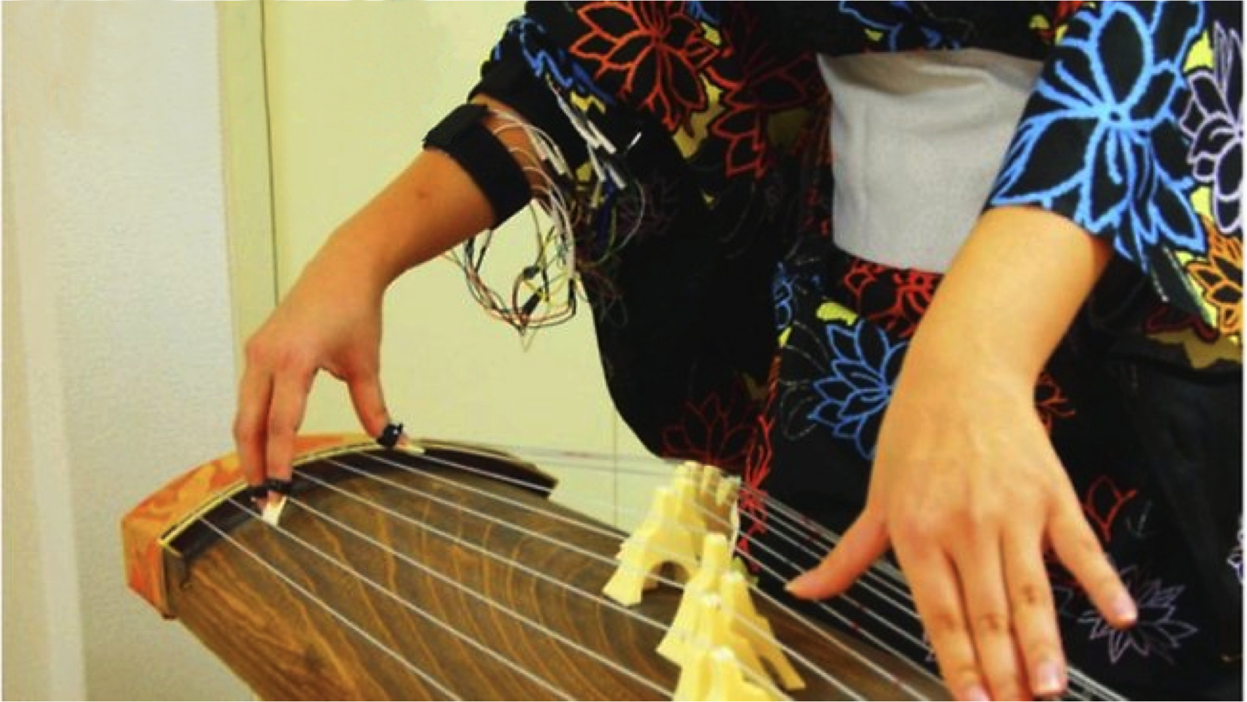
mediating input in learning tasks such as
playing a “new instrument”
[tamaki & rekimoto, ‘11]

Slide 20
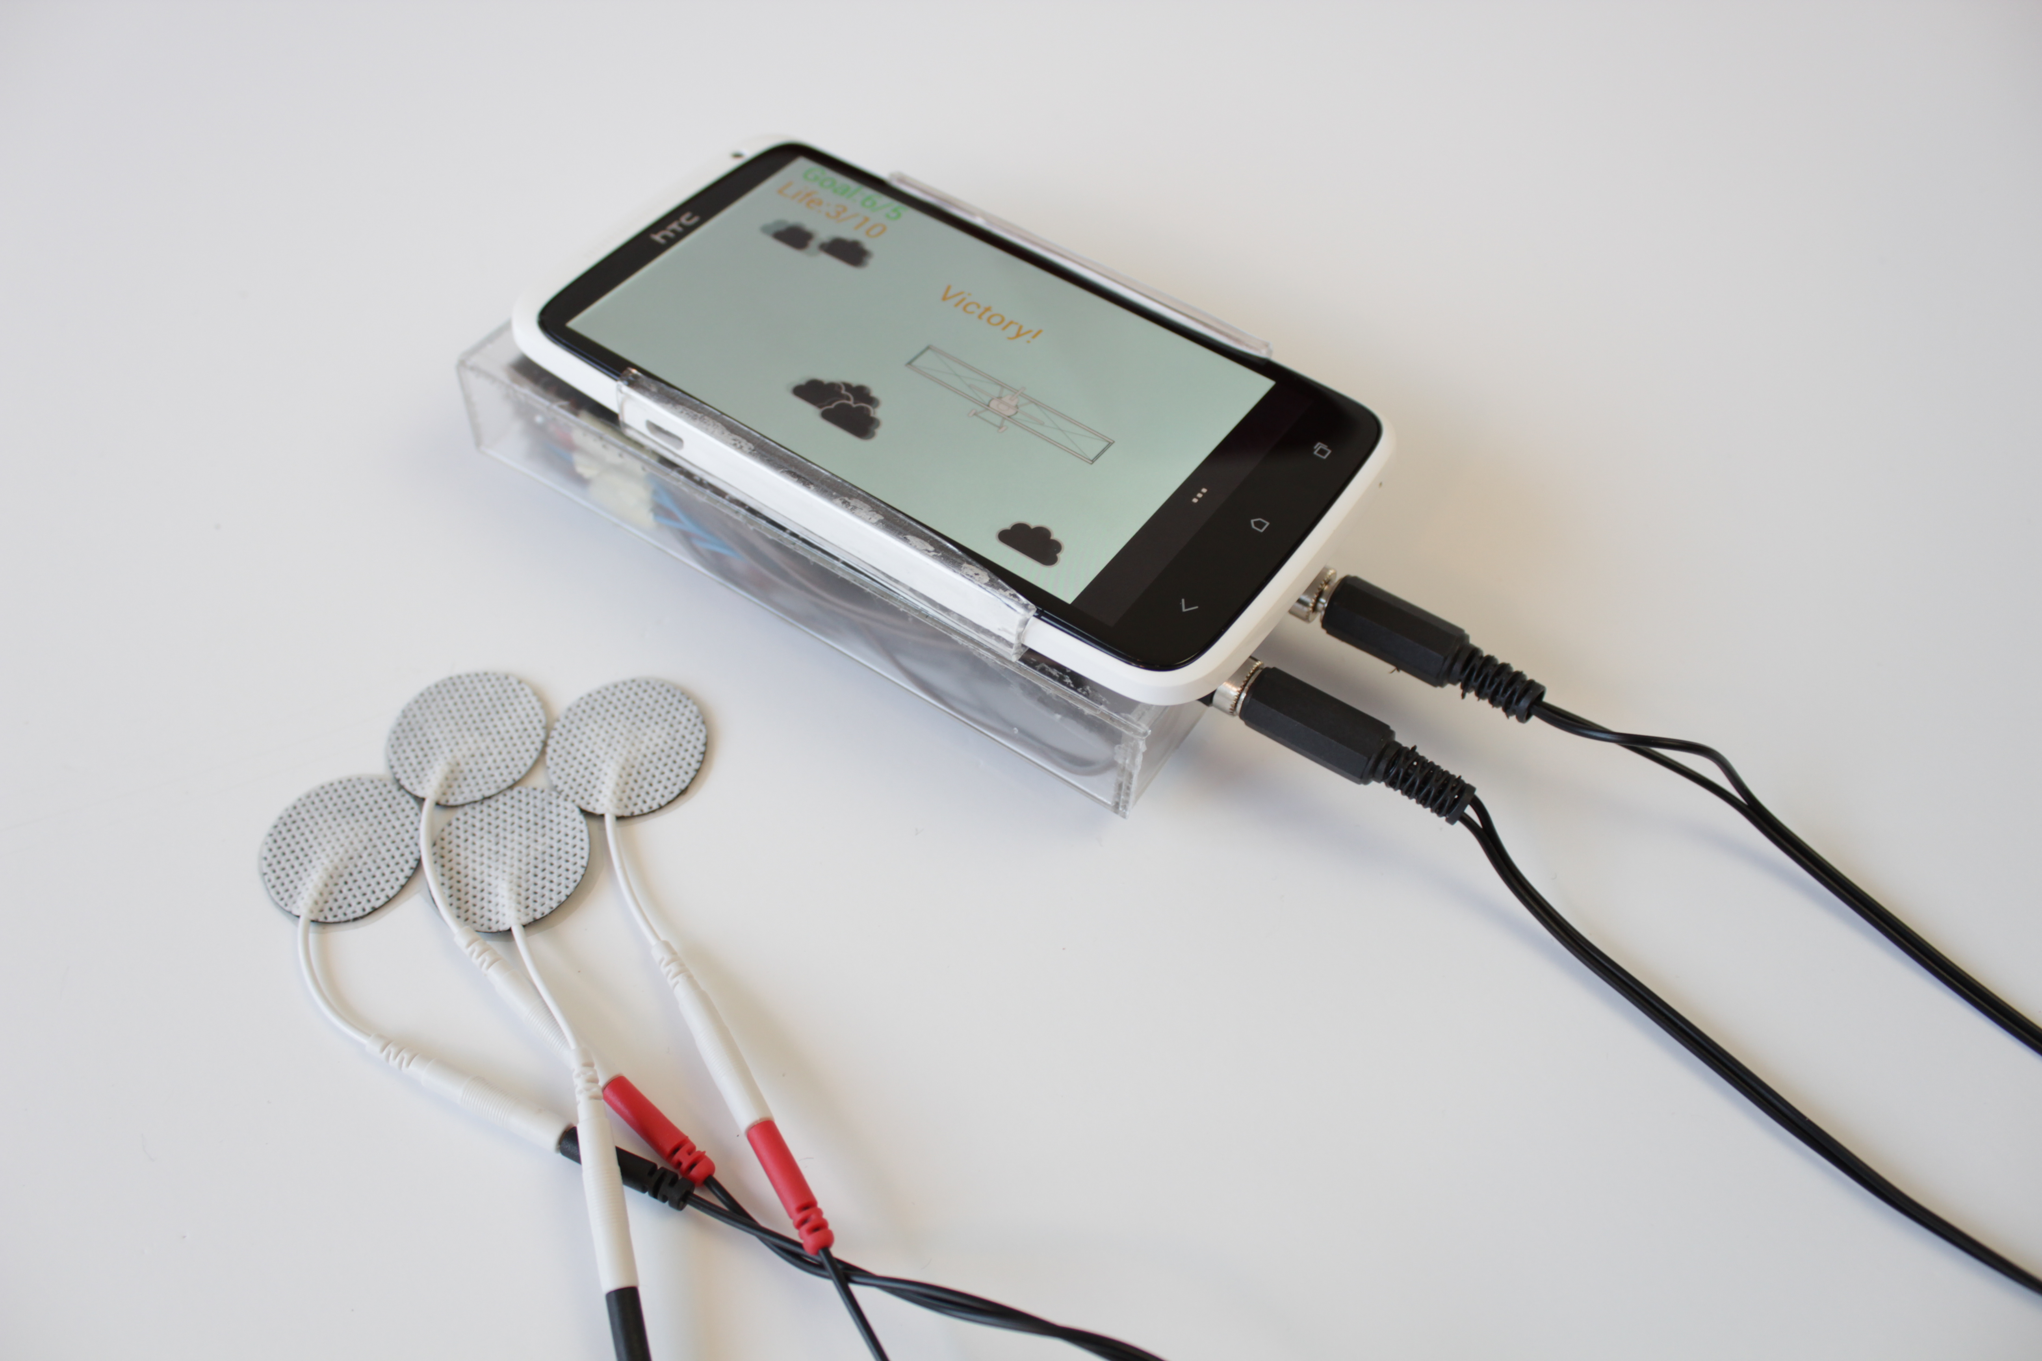
experience:: mobile force-feedback

Slide 21
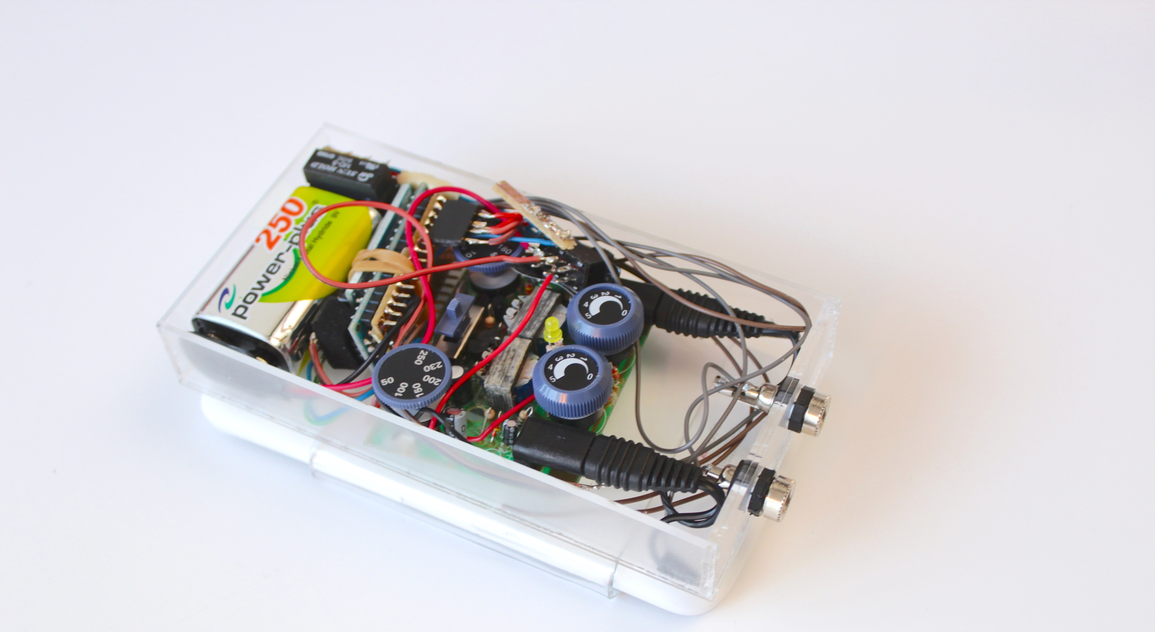
android phone
w/ accelerometers

Slide 22
bluetooth

Slide 23
a tiny computer

Slide 24
electrical stimulation
Notes:
medical compliant

Slide 25
medical compliant
amplifiers (50v/100mA)

Slide 26
hack #1: “old school” style
relays, unmodified circuitry

Slide 27
hack #2: “proxy” style
digital potentiometer, 3 wire protocol, ~5k

Slide 28
how much force can it really generate?
(i.e., could you lift a water bottle?)

Slide 29
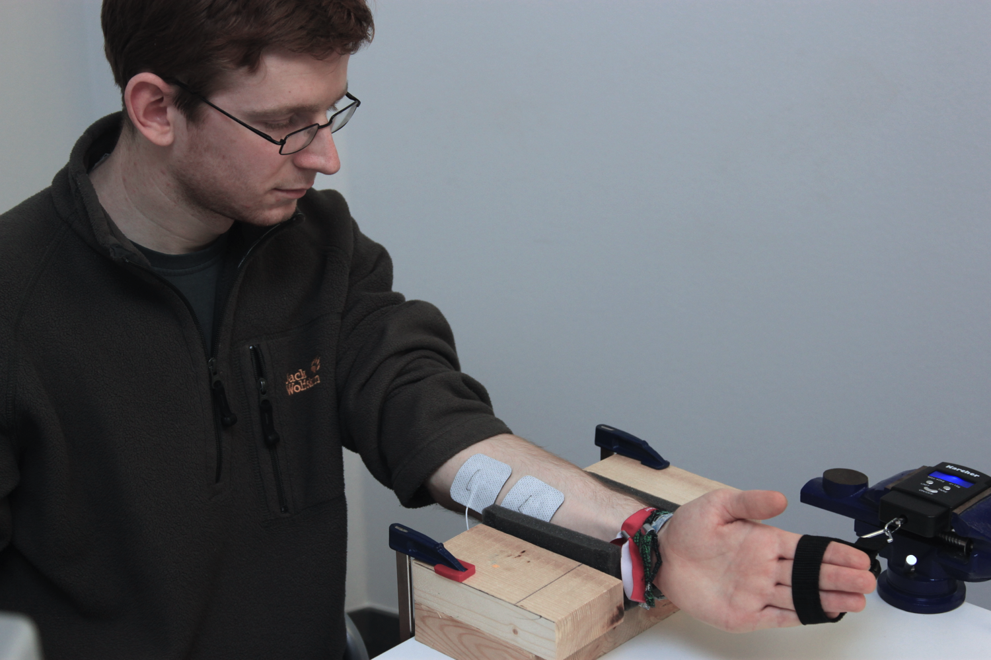
arm rest

Slide 30
electrodes
spring-scale
Notes:
range: from just barely noticeable to (SLOW) still completely pain-free
----- Meeting Notes (4/24/13 12:39) -----
we wanted to make sure that the sensation… . is comparable woth force feedback.

Slide 31
study 1: enough force?
2000 g
intensity
6
5
4
3
2
1
50 ms
1000 ms

Slide 32
study 1: enough force?
produces up to 18.7N
~ lifting 2l or 1/2 gallon
2000 g
intensity
6
5
4
3
2
1
50 ms
1000 ms

Slide 33
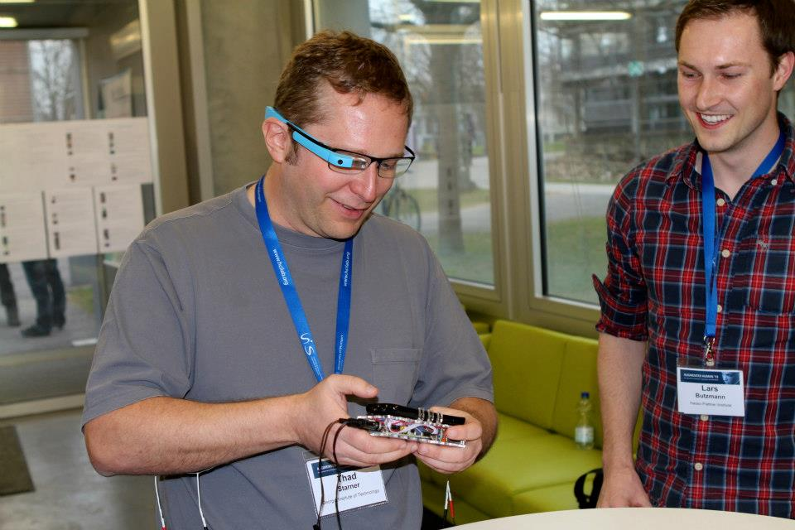
remarkable user reactions and excitement
Notes:
STUTTGART
While certainly not ready for mass consumption at this stage, moving the electrical muscle stimulation (never abbreviate) was a big step forward in terms for form factor for us.
, and it seemed to generate a lot of interest within our community

Slide 34
muscle-propelled interfaces are substantially smaller than mechanical actuators, about the size of a phone.. we started wondering: could we make it smaller?

Slide 35
conclusions [wearables that talk directly to the body]
Notes:
presentation goes up again, to the level that people at RS can relate to…

Slide 36
contribution:: force feedback without motor
Notes:
While the topic is fairly well understood for stationary hardware, I am exploring how to create mobile hardware that achieves this. <show the motor-to-muscle, exoskeleton-to-skeleton slide again--it is the most important you have> My current approach is to use the user's body itself, i.e., to replace motors with muscles and exoskeletons with skeletons.
fuethemrore, trend 1 -> mobility // trend 2 -> immersion
Our research points out that "feeling forces" is the next step for increased realism in human computer interfaces, and a way of creating very small mobile devices. For a long time, the key to immersion in interactive experience and games was sought in photorealistic graphics. Now, interfaces and games became more immersive by requiring us to physically enact, such as with Wii or Kinect. With graphics and user interaction now part of many games, many researchers argue that haptics and motion are the next step towards increasing realism. However, when it comes to output, we have nothing more than vibrating buzzers, such as the ones that make our smartphones vibrate. In this talk, we show compelling new ultra­mobile technologies that provide exciting haptic feedback. Our approaches achieve a low hardware footprint by leveraging use our own muscle power! We will demonstrate several projects that allow for interaction to become more
immersive.
impossible to combine the axis, but that is where our work lives

Slide 37
acknowledgements [for all those who helped me]
Notes:
presentation goes up again, to the level that people at RS can relate to…

Slide 38



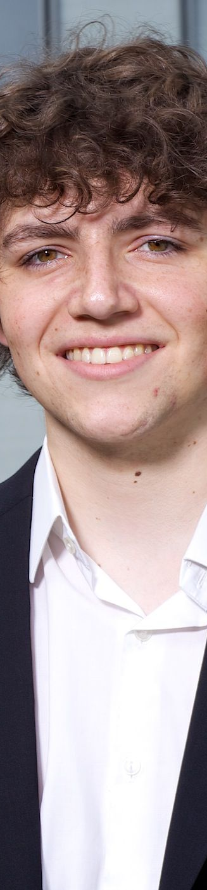
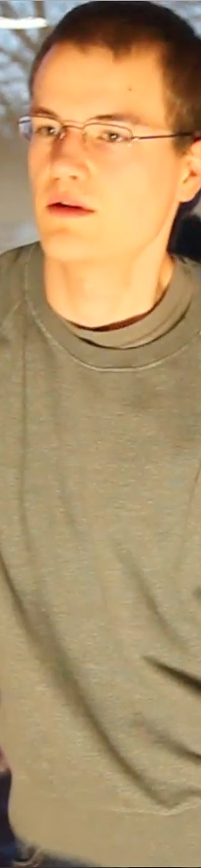


Slide 39
thanks, questions?
Notes:
RS / 15min. beef up

